Slide 1
Alternative Splicing of the PKCδ Gene
Amanda Morris
Umberto napoletano
Jesse robinson
Dr. Audrey shor
Dr. niketa patel

Slide 2
Objective of Project
To increase understanding of the structure and functions of PKCδ through the use of structural alignment, protein modeling and gene mapping.

Slide 3
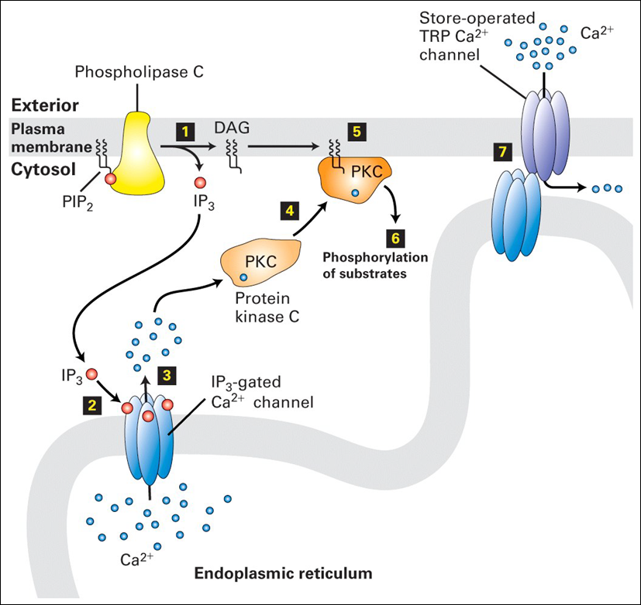
History of PKC
First discovered in 1977
Activated by DAG and Calcium
Some exceptions
3 classes
Classical
Novel
Atypical
http://www.studyblue.com/notes/note/n/pharmacology-test-2/deck/45321

Slide 4
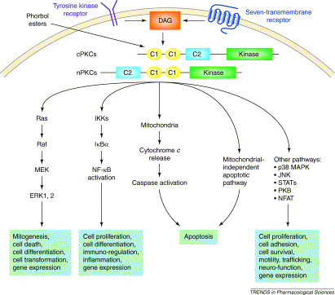
PKCδ
Novel PKC
Calcium independent
11 isoforms
PKCδI and VIII are human variants
Opposing functions
PKCδI: Apoptosis
PKCδVIII: Pro-survival

Slide 5
PKCδ
http://atlasgeneticsoncology.org/Genes/PRKCDID42901ch3p21.html

Slide 6
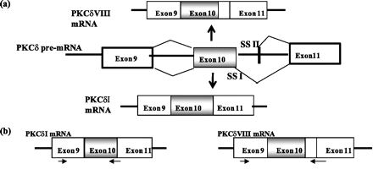
Opposing Functions
Alternative splicing
Addition of 31 nucleotides between exons 10 and 11
Interruption of hinge region
Cleavage necessary for activation
http://www.jbc.org/content/285/34/25987

Slide 7
Retinoic Acid and SC35
RA promotes alternative splicing
SC35
Includes 93 nucleotides from intron
PKCδVIII is created
http://www.jbc.org/content/285/34/25987

Slide 8
Model

Slide 9
Objective of Instructional Materials
To improve the understanding of how alternative splicing and post-translational modifications can alter the function of PKCδ isoforms.

Slide 10
Gene Map
Obtained mRNA sequence from NCBI
Additional nucleotides from NCBI
Protein sequence “hidden” across 3 reading frames
Each frame was aligned (RNA,1,2,3)
Instructional guidelines
Protein Sequence
mRNA sequence
Differing functions

